Slide 1
Project on: Smart Notice Board
Presented By
Mili Akter
Id: 180322036
Supervised By:
Jasmin Akter
Lecturer, Dept. of CSE,
Taslim Anwar
Tasfia Akter Dolon
Asfaque Ahmed Bhuiyan
Id: 180322100
Id: 180222040
Id: 180222059
European University of Bangladesh
Thursday 4th November 2021

Slide 2
Outline
Introduction
Related Works
Motivation for The Work
Objective
Approach
How works the system
Date of completion
Conclusion

Slide 3
Introduction
Notice Board Android Application
Automated notice system
Daily notice update

Slide 4
Related Works
Title: “নোটিশ বোর্ড”
Type: Android Application
Limitations/Problems:
1. Only Job related notices
2. No educational approaches

Slide 5
Motivation
Get updated notice on app during vacation.
It’s not always easy to access notices through email everywhere, but mobile app is very simple to use.

Slide 6
Objective
The main objectives of the proposed work are listed below:
Create notice by authorized teachers
Create general notice and department basis notice
Get notification when new notice is updated

Slide 7

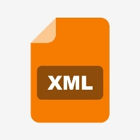


Approach
Platform/Framework | Backend | GUI | Database
Native Android with Android Studio | Java | XML | Firebase Realtime Database

Slide 8
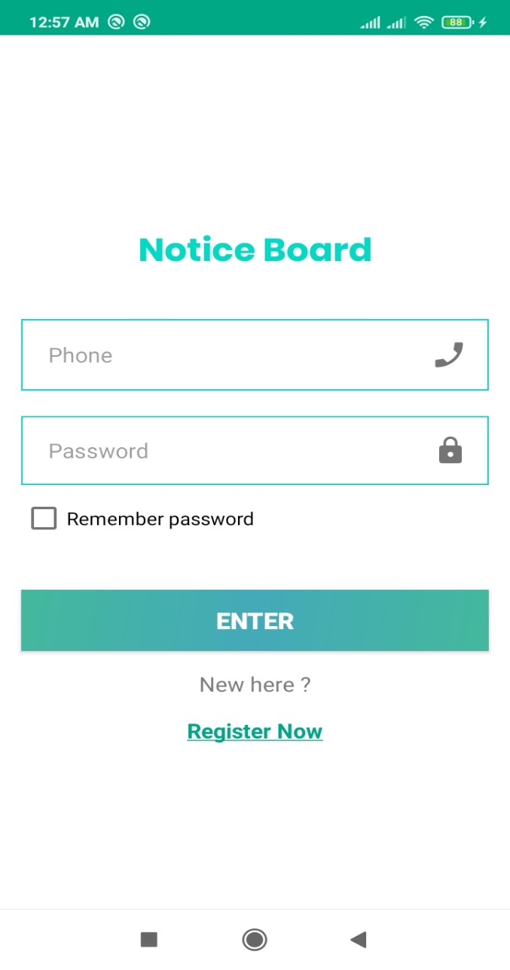
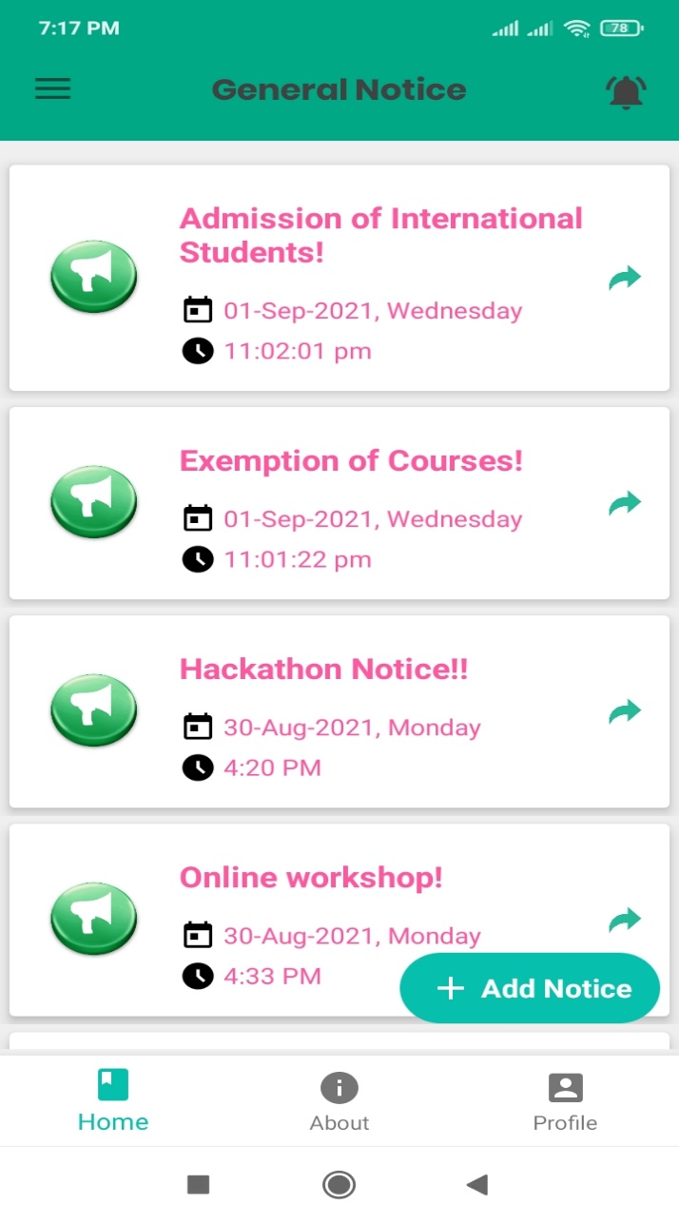
How the proposed system will work (Feature)
Register & Login
Home

Slide 9
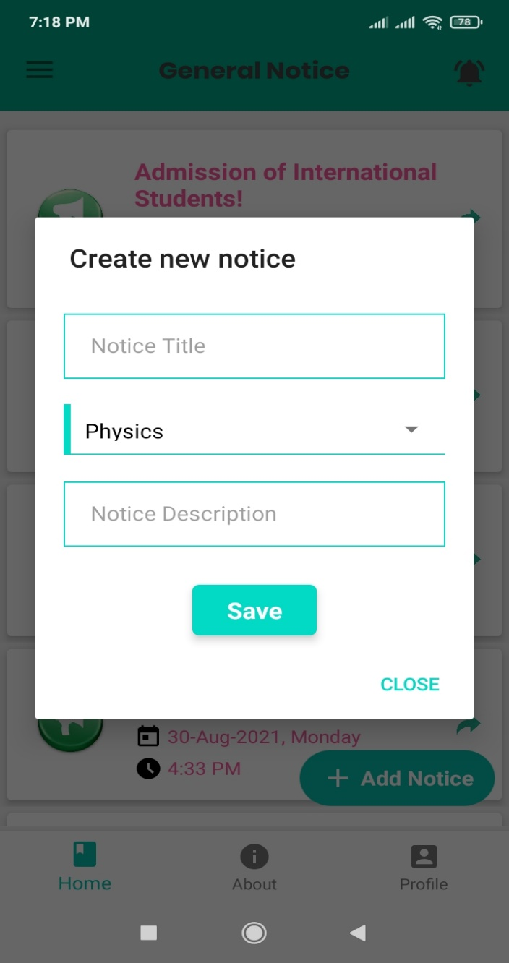
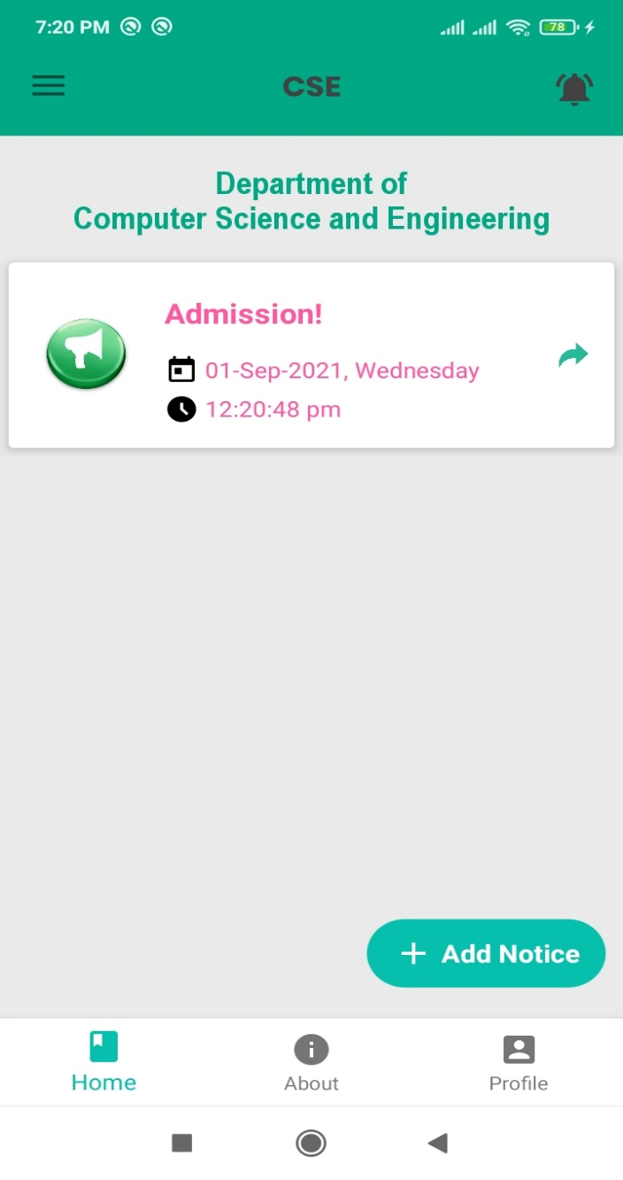
Feature (continue…)
Create Notice
Department Basis Notice

Slide 10
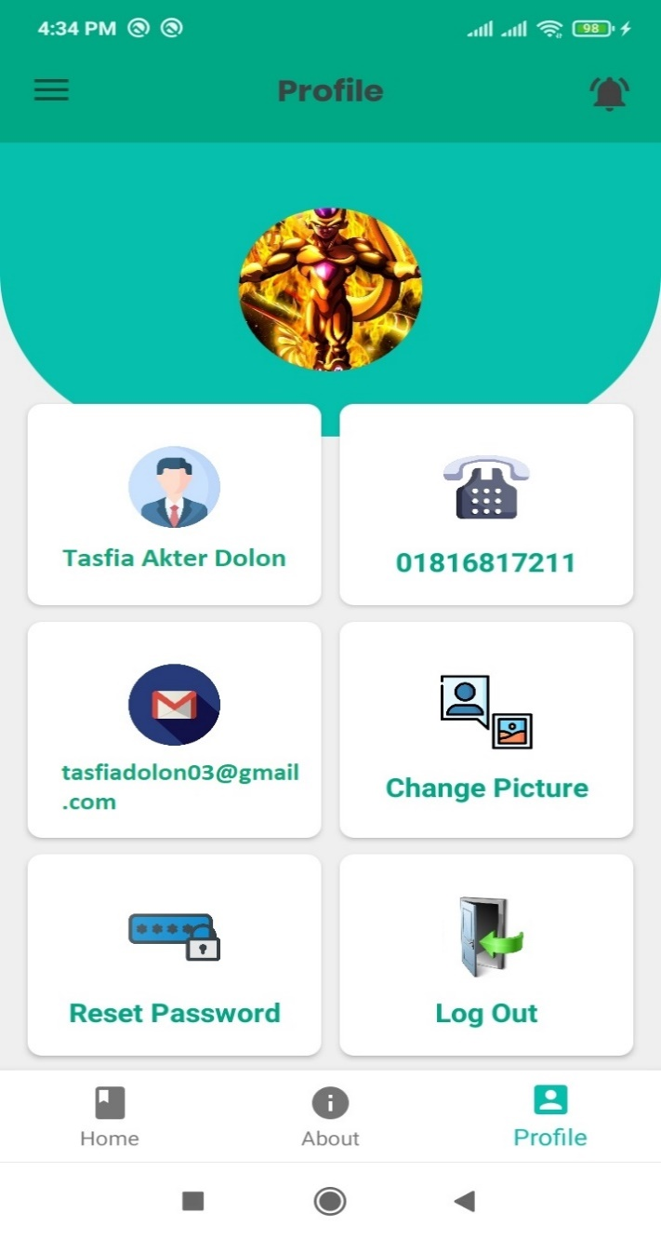
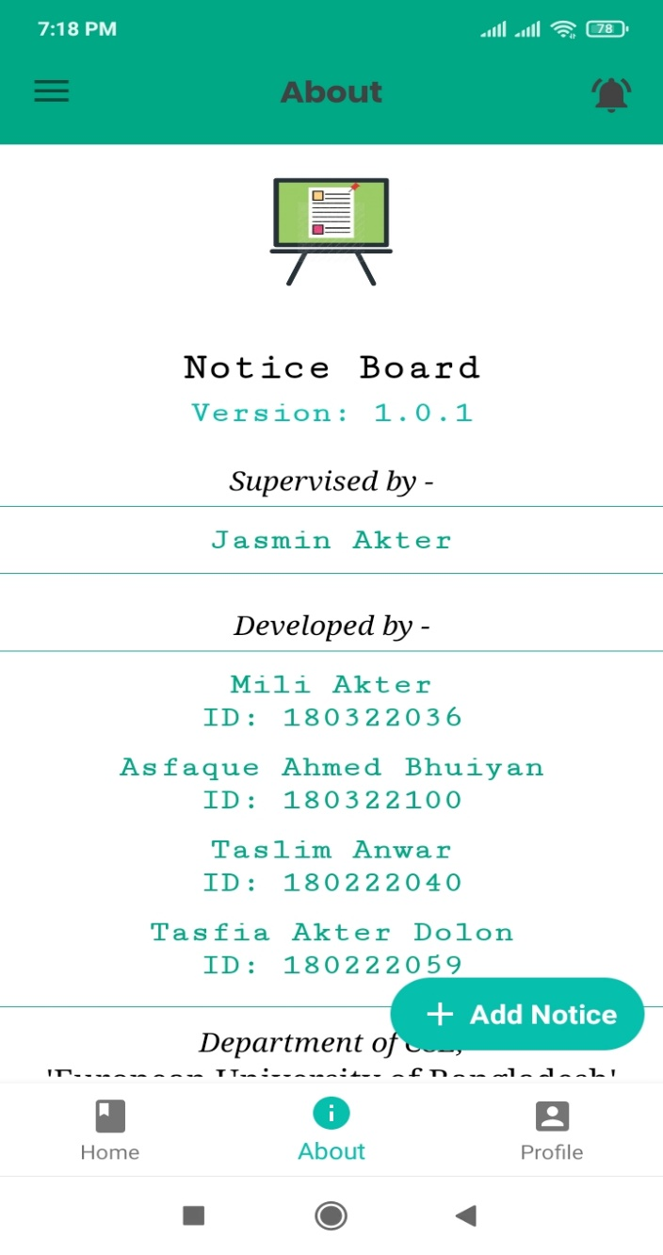
Feature (continue…)
Profile
About

Slide 11
Date of completion
I will finished up to the detection and evaluation of my proposed work within October 14, 2019.

Slide 12
Conclusion
The project “Smart Notice Board” has been successfully completed and tested with troubleshooting to the best of our knowledge.
The project is very cost efficient and user friendly. We believe that our project can become educational which can be used in places such as universities and other educational institutes.

Slide 13
Thank you

